Slide 1
An United approach to alcohol policy in Africa?
25th November 2022
Aadielah Maker Diedericks

Slide 2
Alcohol and Africa
Lifetime abstainers = 57.5%
Current drinkers = 32.2%
Heavy episodic drinkers 15-24 year olds
Globally highest age-standardized alcohol attributable burden of injury and disease
Industry profits dependent on heavy drinkers
https://www.oecd.org/publications/preventing-harmful-alcohol-use-6e4b4ffb-en.htm

Slide 3
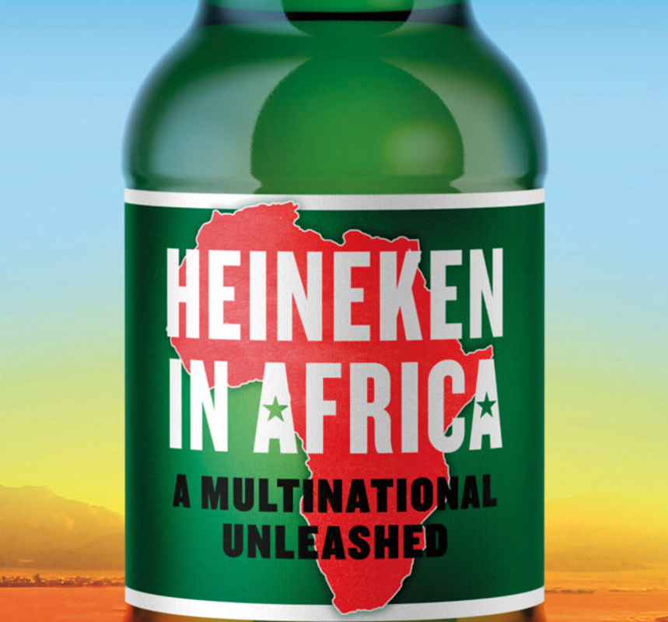
Alcohol Industry and Africa
Attractive
youth population - estimated 60% under 25 years by 2050
increasing middle class
limited policy
Increased regulation in the North
Scramble
Interfere

Slide 4
Evidence
Alcohol advertising influence early experimentation
Influence volume consumed in one sitting binge
Jernigan D, Noel J, Landon J, Thornton N, Lobstein T. Alcohol marketing and youth alcohol consumption: a systematic review of longitudinal studies published since 2008. Addiction. 2017 Jan;112 Suppl 1:7-20. doi: 10.1111/add.13591. Epub 2016 Nov 8. PMID: 27565582 https://pubmed.ncbi.nlm.nih.gov/27565582/

Slide 5
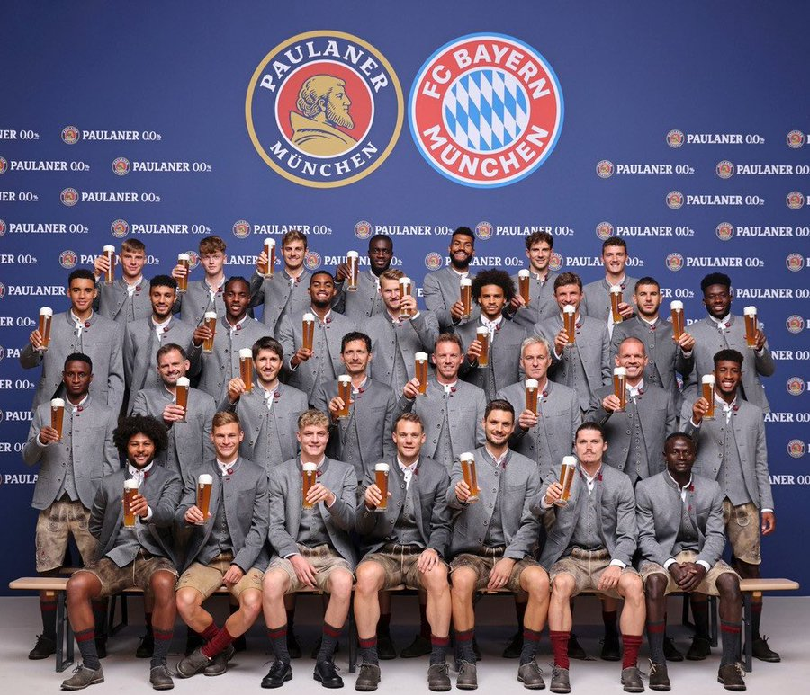

Slide 6
Alcohol policy in Africa
more than 50% of countries don’t have alcohol policies
UGANDA have adopted SAFER
Botswana introduced levy
Reduced since 2018
Reintroduced alcohol sales into stadiums
South Africa
Stalled legislation –industry using socio-economic impact assessments

Slide 7
Alcohol advocacy in Africa
3 sister Alliances – EAAPA, SAAPA, WAAPA
Accelerate & amplify collective action
African Alcohol Policy Alliance
Interim committee
TOR discussions
World No Alcohol Day
GAPC2023 (samrc.ac.za)

Slide 8
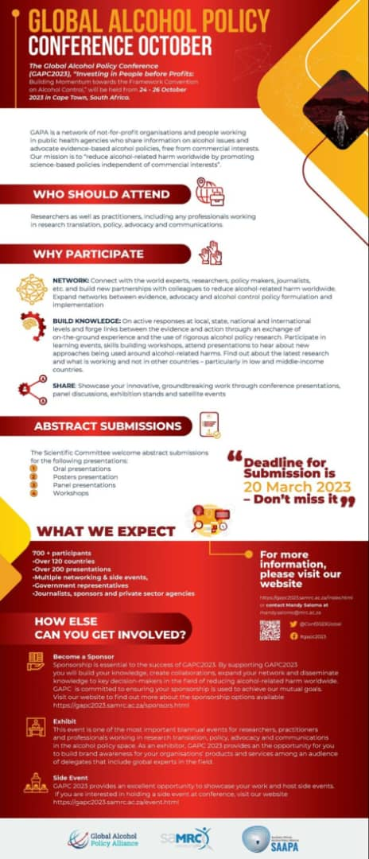

Slide 9
?????

